Slide 1
Imagine Cup Junior
Lesson Six– How to make your submission great.
Notes:
This is a title slide that you can have up at the beginning of Lesson Five of this Imagine Cup Junior lesson.

Slide 2

Challenge Check-in
What have you done so far?
You formed a team and identified a specific problem from one of the AI for Good categories. You have formed a team, selected a problem and learned more about it.
You have learned about the basics of AI and how to build with APIs.
You learned about the Microsoft Ethic Principles and applied them to your idea to.
You took a deep dive into cybersecurity and made sure your idea is cyber safe
What is next?
This is the last lesson and is designed to help your team do the final preparations to submit your entry to Imagine Cup Junior.
Notes:
Challenge check-in. This slide is a check-in to recap what the students have gone through, and to remind that this is the final lesson.

Slide 3






What we will be doing across the six Imagine Cup Junior lessons.
Lesson 1
Lesson 2
Lesson 3
Forming your team and choosing your problem.
Learning about how AI works.
Learning about generative AI.
Lesson 4
Lesson 5
Lesson 6
Becoming a team of AI inventors.
Making sure your AI is good and cyber secure.
Entering a great submission to Imagine Cup Junior.
Notes:
Slide 3: This slide is a visual overview for the students of what they will be doing in Imagine Cup Junior. This is to show them that this is the final lesson and that they should submit today or be close to submitting!

Slide 4

How do you submit your entry to Imagine Cup Junior?
To enter Imagine Cup Junior, your team needs to complete the PowerPoint Submission template slide deck including a brief video (see full submission requirements in the Rules and Regulations document)
Your educator, parent or guardian will upload your PowerPoint submission at the Imagine Cup Junior site: Imagine Cup Junior 2023 | Imagine Cup (microsoft.com)
You must have your entry in before 10 May 2023
Notes:
How to submit to Imagine Cup Junior. This slide is designed to give very specific instructions to your students about how they submit. In this final lesson they can:
1. Do some final work as a team to make sure they are happy with their AI concept. (In this lesson we are going to give them plenty of tips!)
2. There is a PowerPoint slide deck that they need to fill out with their entry. They need to use this template and their submission can be no more than 10 slides. Educators, you can download this PowerPoint template at https://imaginecup.microsoft.com/en-us/junior.
3. As an educator you will then need to submit students' PowerPoint entries at https://imaginecup.microsoft.com/en-us/junior. A parent or guardian can also do this.

Slide 5

As a team determine what your big goals are for this lesson. What must you get done in the next 40 minutes to help you put in a great submission to Imagine Cup Junior?
Rapid Reflection
Notes:
Slide 5: Rapid Reflection: This is a chance for your teams determine what their big goals are for this lesson. In particular what must they get done in the next 40 minutes to help them put in a great submission to Imagine Cup Junior?

Slide 6
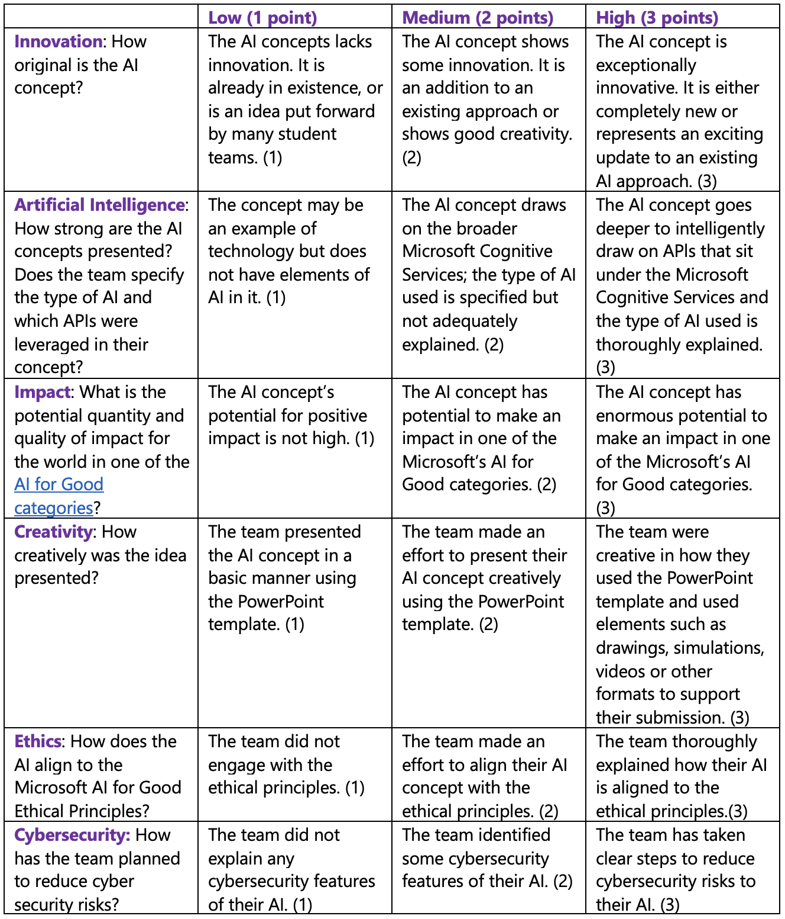
How your entries are judged
This is the rubric used by the judges to assess your student’s submissions. You can share this with your class and use it to guide their AI concepts as they fill out their PowerPoint Submission Template.
Notes:
How your entry is judged. On this slide we share the judging rubric that is applied to your students' submissions. If they want to do well, the easiest way to get points is to keep all of these criteria in mind!

Slide 7
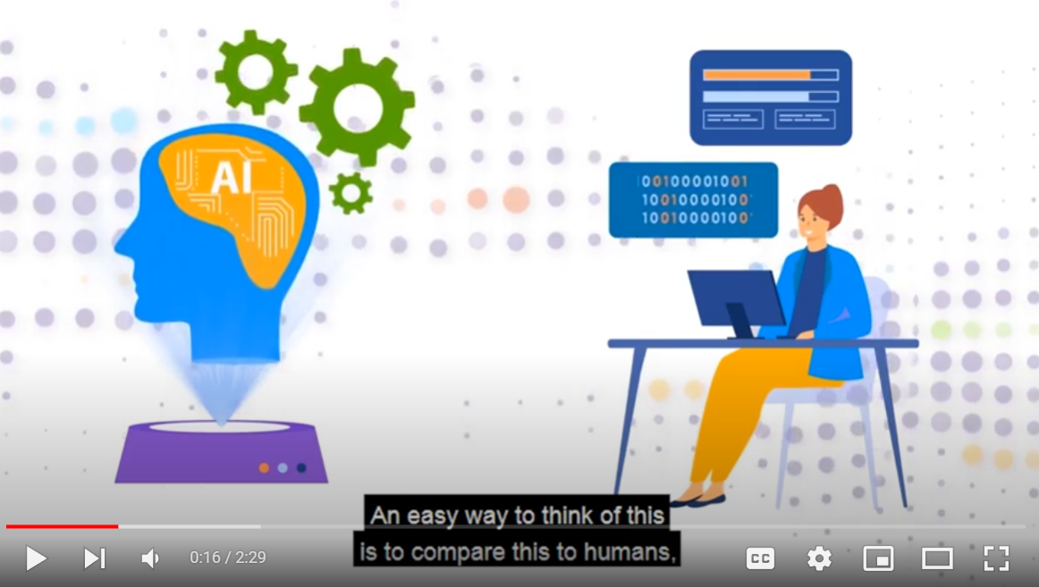

Tips for a great idea and submission | PART 1
Tips for a great idea and submission Part 1 | https://youtu.be/4ETqXdCPnE8
Notes:
In this video we share three of the nine submissions tips for this lesson.

Slide 8

Sprint 1 Your submission
Sprint 2
Your submission
Sprint 1 – Your Submission
Goals:
Continue to move towards finishing your AI concept and filling out the PowerPoint Submission Template.
Hints:
1. The ‘In a sentence’ section on the title page is very important. 2. Fill out every slide. 3. Make sure you explain your idea simply.
Notes:
Slide 8: Sprint One - In this first sprint of three your students can work on their submission using the tips listed on the slide (the same tips covered in the previous video).

Slide 9
Tips for a great idea and submission | PART 2
Tips for a great idea and submission Part 2 | https://youtu.be/a7iV-F0ca5I
Notes:
Slide 9: In this video we share the next three tips of the nine submissions tips for this lesson.

Slide 10
Sprint 1 Your submission
Sprint 2
Your submission
Sprint 2 – Your Submission
Goals:
Continue to move towards finishing your AI concept and filling out the PowerPoint Submission Template. Only two more sprints to go (including this one!)
Hints:
4. A picture says a thousand words! 5. Get creative with your PowerPoint slide deck. 6. Clearly show it is AI (using APIs!).
Notes:
Slide 10: Sprint Two - In the second sprint of three your students can work on their submission using the tips listed on the slide (the same tips covered in the previous video).

Slide 11
Tips for a great idea and submission | PART 3
Tips for a great idea and submission Part 3 | https://youtu.be/5UyE_7r9H5s
Notes:
Slide 11: In this video we share the final three tips of the nine submissions tips for this lesson.

Slide 12
Sprint 1
Sprint 2
Sprint 3 – Your Submission
Goals:
This is your last sprint. Make sure when you are finished with your PowerPoint submission that you pass it onto your educator/parent/sponsor for them to submit for you at: https://imaginecup.microsoft.com/junior
Hints:
7. Be sure to show how your idea is innovative and unique. 8. Explain how your AI meets the ethical principles. 9. Inspire the judges that your idea will solve the problem you identified, at a large scale!
Notes:
Slide 12: Sprint Three - In the third and final sprint of three your students can work on their submission using the tips listed on the slide (the same tips covered in the previous video).

Slide 13
Challenge Check-in
What have you done so far?
You formed a team and identified a specific problem from one of the AI for Good categories. You have formed a team, selected a problem and learned more about it.
You have learned about the basics of AI and how to build with APIs.
You learned about the Microsoft AI Principles and applied them to your idea to.
This is the last lesson and is designed to help your team do the final preparations to submit your entry to Imagine Cup Junior.
Notes:
Challenge check-in. This slide is a check-in to recap what the students got up to through the five lessons!

Slide 14
Good Luck with Imagine Cup Junior
Good Luck with Imagine Cup Junior | https://youtu.be/N7ok1-7pmlk
Notes:
Congratulations on getting this far! We look forward to seeing your project!

